Slide 1
Self-Help
Housing 101

Slide 2
What is Mutual Self-Help Housing?
A method for achieving homeownership
Families working together
Affordable homeownership loans
A private non-profit or local government sponsor

Slide 3
Similar to the church and barn raising of the Amish and Mennonites
Rural Development began funding mortgages through their 502 program in the 1960’s
In 1971 Rural Development began the 523 Grant Program

Slide 4
Over 40,000 homes have been successfully built through this method
At one time, all 50 states have participated in the Rural Development Mutual Self-Help Program

Slide 5
Merits of Self-Help Housing
Affordable, comfortable and attractive homes
Uses the best most affordable financing around
Reduced mortgage – saving an average of $33,580 in FY ‘09

Slide 6
Improved opportunity for value appreciation and equity growth
Participants learn valuable skills
Builds strong neighborhoods and communities

Slide 7
Three Necessary Elements
The participants supply the needed labor
Rural Development provides the 502 and 523 funds
Housing corporations organize and assist the families
Notes:
Three elements ate necessary to make self-help housing work
Families who want their own homes and are willing to do most of the work building those homes.
Rural Development providing the 502 rural housing mortgages loans needed to purchase the land, building materials and some subcontracted work
Rural Development also provides the 523 grant funds to eligible housing organizations. These funds allow the housing organizations to fund the administrative costs and provide to provide this program.
And finally an eligible housing organization that works with the families by providing the assistance and training necessary to fulfill the goals of the self-help program. Skilled staff will help you with your loan applications to Rural Development, provide you with construction training and supervision on the construction site, and assist you with the accounting and bill paying throughout the construction process.

Slide 8
Grantee Responsibilities
Recruiting participants
Conducting pre-construction meetings
Locating suitable building sites
Selecting house plans
Preparing cost estimates

Slide 9
Assisting participants in applying for a 502 loan
Subcontracting work on the participants’ behalf
Supervising and training participants in the construction of a group of homes
Supervising the participants’ 502 loan funds

Slide 10
How the Homes are Built
Families work together in groups of 4-10
Houses start and finish construction together
No one moves in until all of the homes are finished and approved

Slide 11
Work is done by the participants in the evenings, on weekends and days off
Families not willing to give up free time should not join a self-help housing group

Slide 12
How long will it take to build the homes?
The total process takes 12 to 16 months
  3 to 4 months in pre-construction
  9 to 12 months in construction

Slide 13
Pre-Construction Period Includes:
Choosing house plans
Selecting building sites
Completing Rural Development paperwork
Awaiting loan approval
Participating in Pre-Construction Meetings

Slide 14
Construction Period
Typical construction time: 1.6 months per house
6 houses = 9 months of construction time

Slide 15
Family Labor Contribution
Families contribute as much labor as is required to complete ALL of the houses in the group
Generally each family contributes 30 to 35 hours each week
Family hours include the labor of either spouse and any child over 16 years of age

Slide 16
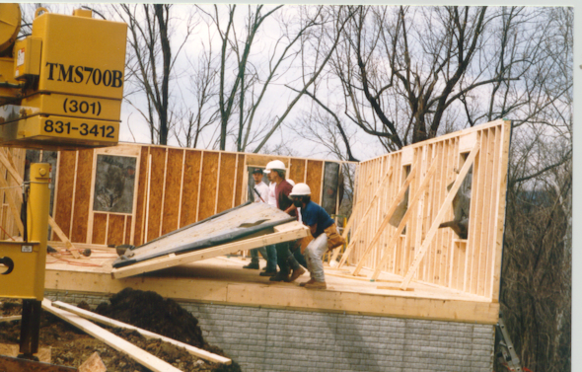

Slide 17
Family Tasks
Families must complete a minimum of 65% of the construction labor tasks
Technical work such as foundation, plumbing, heating and electrical is subcontracted out

Slide 18
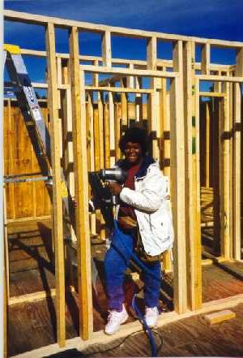
Families generally will do such tasks as:
  framing
  setting of trusses
  roofing
  insulation
  sheathing
  siding
  windows & doors
  drywall
  painting
  interior trim & cabinets
  landscaping

Slide 19
Self-Help
Purchase / Repair
Purchase / Repair is allowed in regulations
Not utilized much over the last 15 years
Now becoming more popular
Organizations can request concurrence to develop a Purchase/Repair Program, subject to NCALL’s recommendation, and the State Director’s approval
NCALL recommends, as a best practice, to also include new construction

Slide 20
Average repairs should be in the $10,000 range
The homeowner will contribute a minimum of 125-150 hours family labor
Repairs will be completed by the new homeowner over an 8-9 week period
Technical Assistance provided by the Self-Help Construction Manager, Project Manager and administrative staff

Slide 21
How do you know if there is a need for a Self-Help Purchase/Repair Program:
  A higher number of quality, lower-cost existing homes on the market
  Much lower mortgage amounts are needed vs new construction
Local banks and Realtors will refer clients
Less family labor hours are needed
Purchasing lower-cost existing homes should result in increased market values
Energy-saving repairs/components will put more sub-contractors to work, and open-up possible tax credits for the homebuyers

Slide 22
Repairs - Each home will be inspected on an individual basis with repairs that will vary
Seek homes built post January 1, 1998, that are structurally sound, but need improvements, that may include:
  Energy-rated furnace
  Duct cleaning and wrapping
  Electrical
  Plumbing
  Energy-rated water heater or on-demand
  Stools, sinks and faucets
  Roof replacement
  Exterior and/or interior paint
  Floor covering
  Windows
  Insulation
  Fill dirt

Slide 23
Application Steps
Pre-Application
  Proof of interested families
  Available, affordable land
  Organizational feasibility

Slide 24
Final Application
  Families 502 eligible
  Land secured
  Staff available
  House plans, specs & estimates complete
  Organizational readiness
Operating Grant
  Production of houses proposed within budget and time allotted

Slide 25
Rural Development Section 523 Pre-Development Grant
Purpose:
Provide an organization with financial assistance to prepare and complete the final application.

Slide 26
Terms:
Six months
Maximum of $10,000
Available only once for a defined area
Cannot be used for land options or building materials

Slide 27
Authorized Uses:
Staff salary, fringes and other office expenses directly related to work on the final application requirements
Obtain house plans, copying etc.
Advertising for eligible applicants

Slide 28
Self-Help Technical Assistance Grant
Purpose:
To pay administrative costs associated with operating a self-help program

Slide 29
Terms:
Rural Development National Office reviews all grants
Grants may not exceed two years
Regional T&MA Contractors and Rural Development Area and State Offices must analyze

Slide 30
Who May Qualify For A 523 Grant
Public Bodies
Rural Towns
Private Non-Profit Corporations

Slide 31
Section 502
Homeownership Loan
Purpose:
To buy an existing home
To buy a lot and construct a home
To rehabilitate a home

Slide 32
Terms:
Effective interest rate based on market rate
Low & very-low families receive reduced interest rates (based on their adjusted annual income)
Families have up to 33 or 38 years to repay

Slide 33
Who May Qualify:
Individuals or families who wish to live in a rural area
Demonstrate repayment ability
Will occupy the house on a permanent basis
Income may not exceed Rural Development guidelines

Slide 34
Other Factors:
Housing must be modest in design
502 loan may cover closing costs, but only up to the appraised value
Escrow for taxes and insurance
Interest and payments are deferred through construction

Slide 35
Benefits of the 502 Loan Program
Effective interest rate below market rate
Payment is based on income and adjusted annually
Repayment period is 33 or 38 years
No down payment is required

Slide 36
Closing costs can be financed into the loan
Interest and mortgage payments are deferred during construction

Slide 37
Who Is NCALL?
Began in 1955 as a legislative advocate
In 1976 started our housing TA on the Delmarva Peninsula

Slide 38
NCALL’s Role in the Self-Help Program
1983 - began a regional self-help contract through USDA Rural Development
NCALL provides assistance to potential and existing self-help housing grantees in 21 states

Slide 39
Services NCALL Provides
Application Training
Program Planning
Construction Scheduling
Grants Management
Staff Training Workshops
Networking Opportunities
Various Other Services

Slide 40
NCALL’s Self-Help Region

Slide 41
NCALL ’s Self-Help
Housing Team
Sherry DeZwarte – Housing Coordinator
Ulla Moore – Housing Specialist
Mark Lasocha – Housing Specialist
Don Pierce – Contracted Housing Specialist
Jill Lordan – Contracted Housing Specialist
Meghan Fitzgerald – Program Analyst

Slide 42
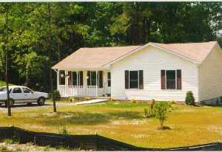
Sample Self-Help Homes
A completed home in southern Maryland, sponsored by Southern Maryland Tri-County Community Action Commission.

Slide 43
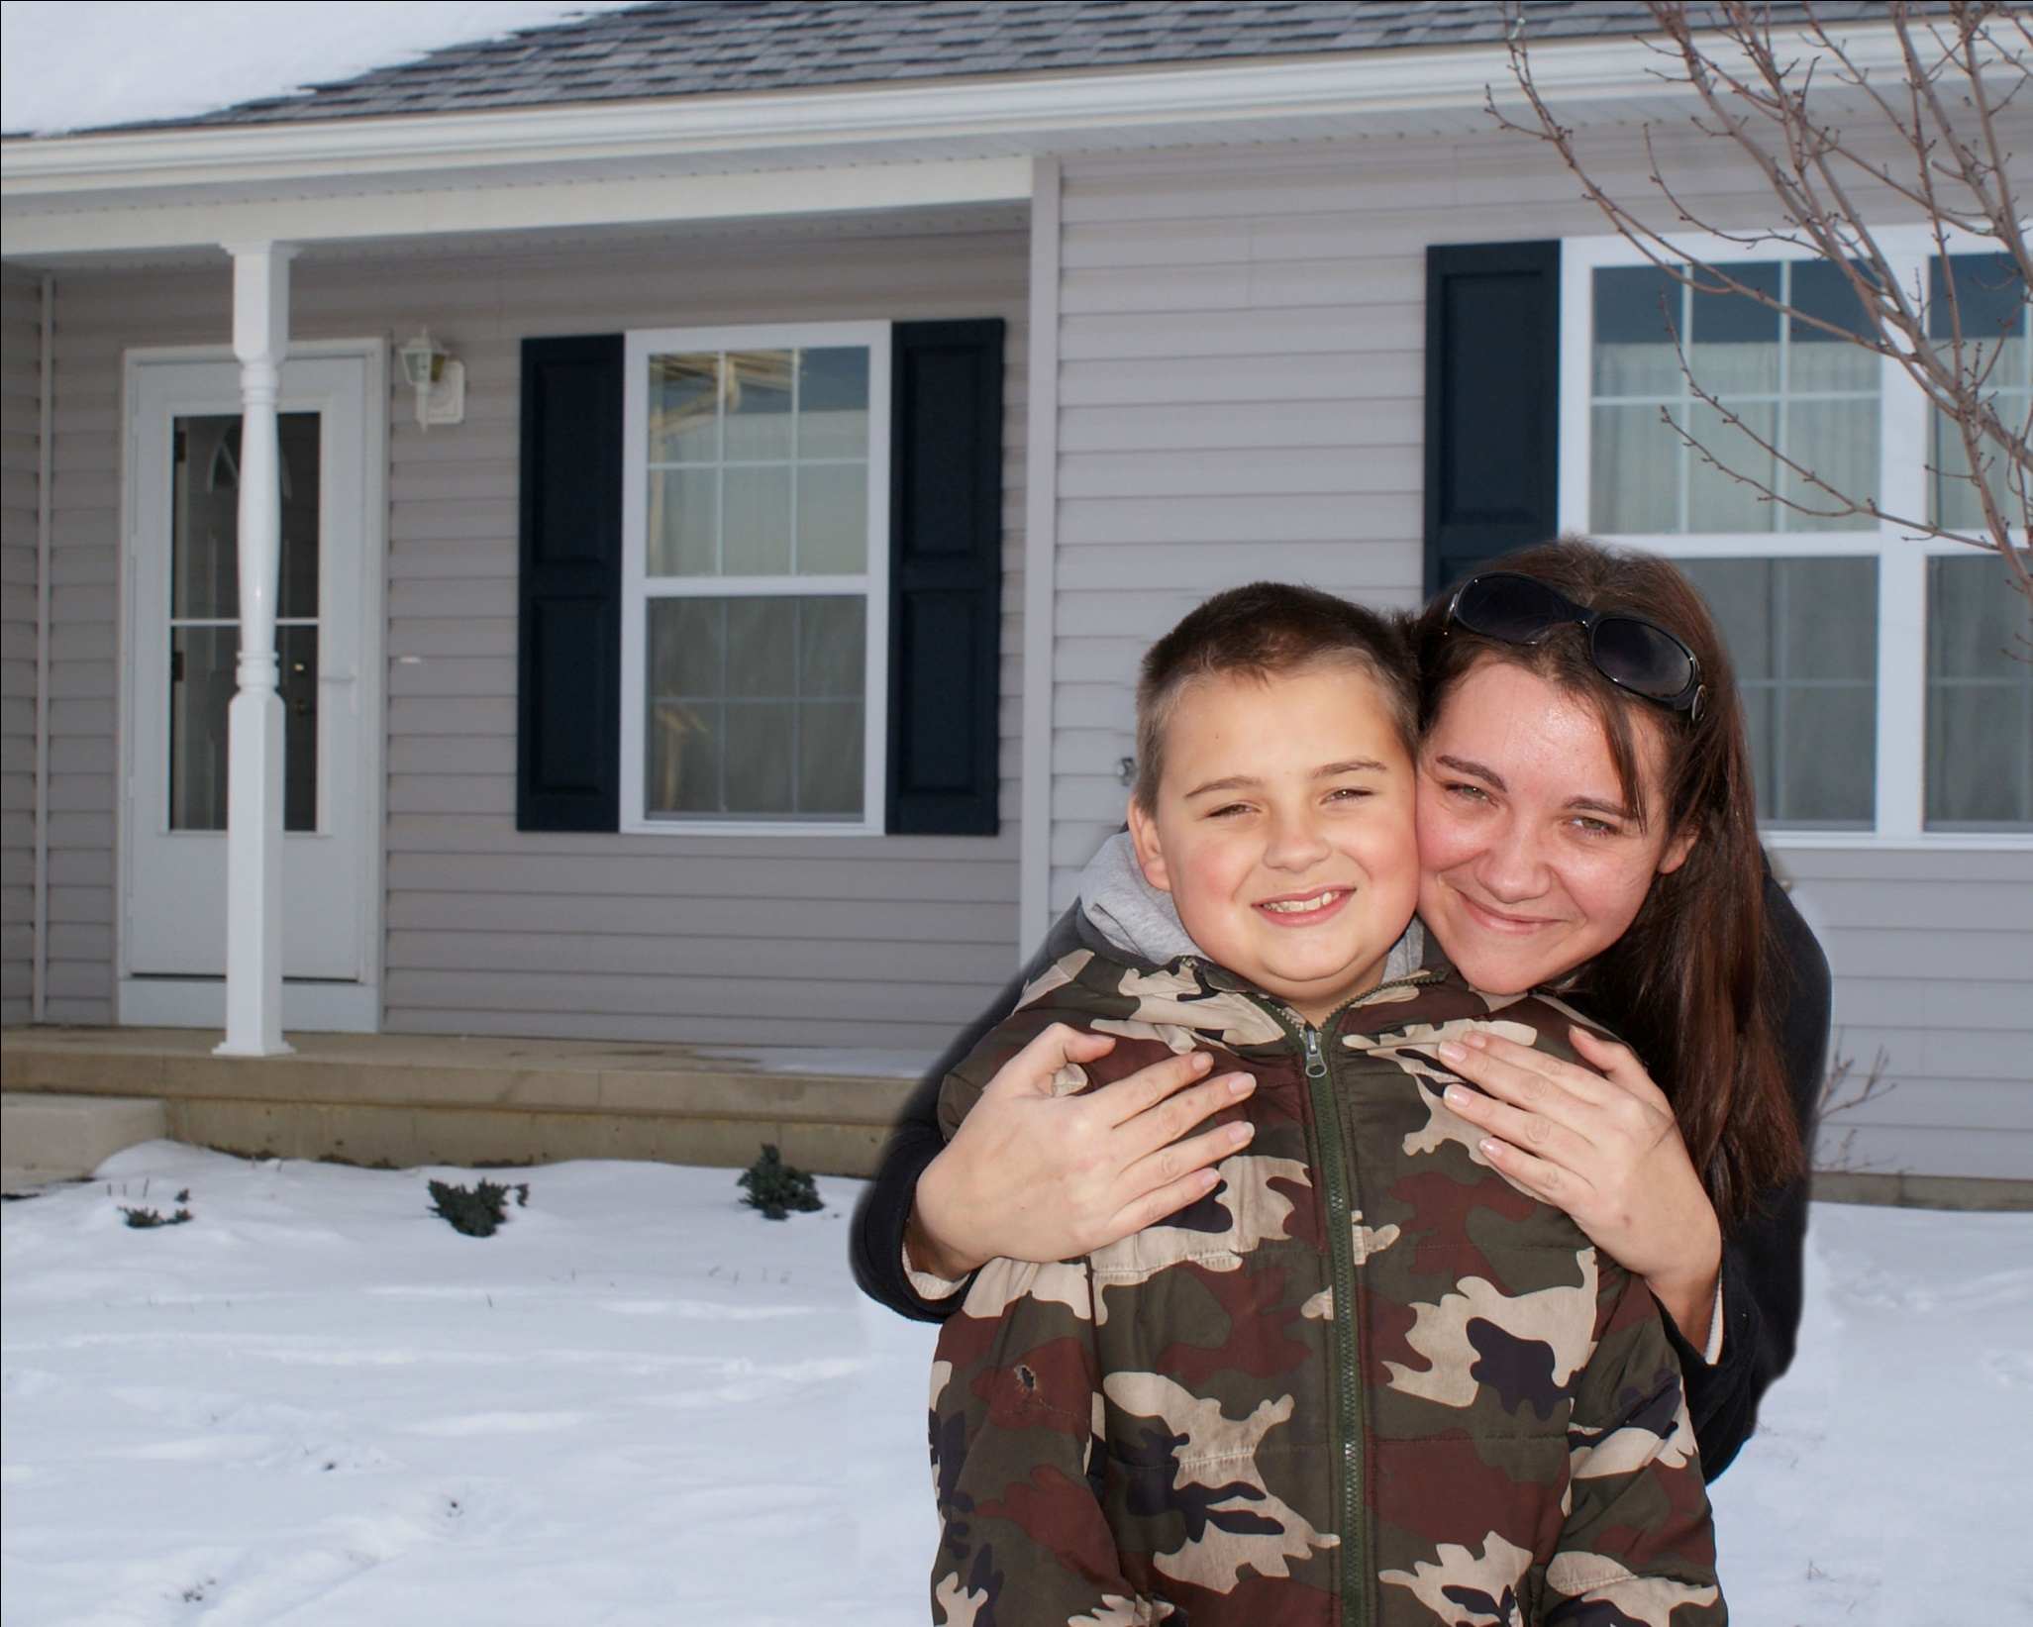

Slide 44
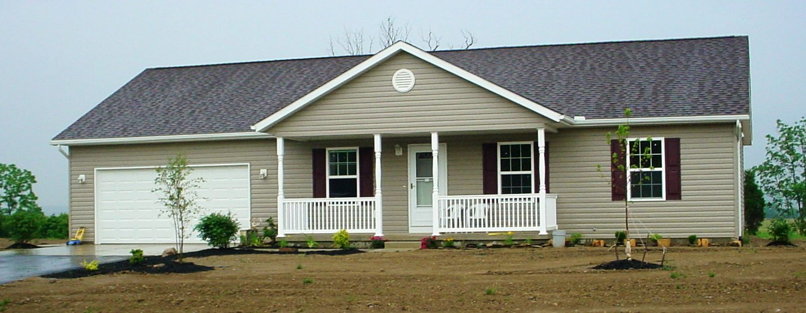

Slide 45
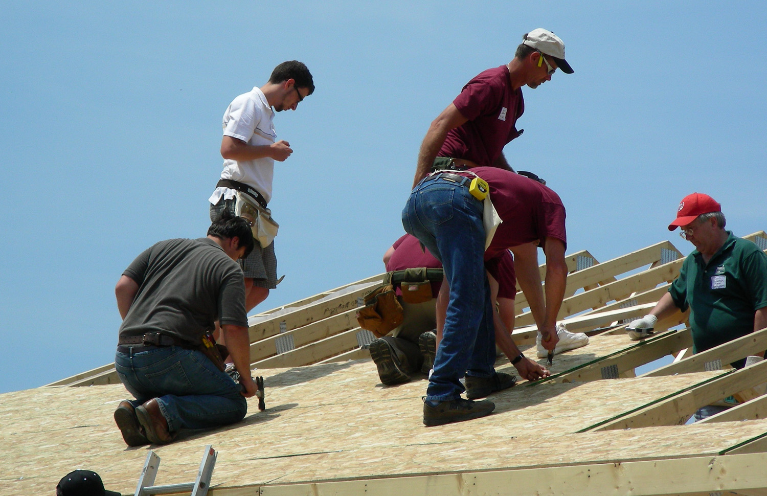

Slide 46
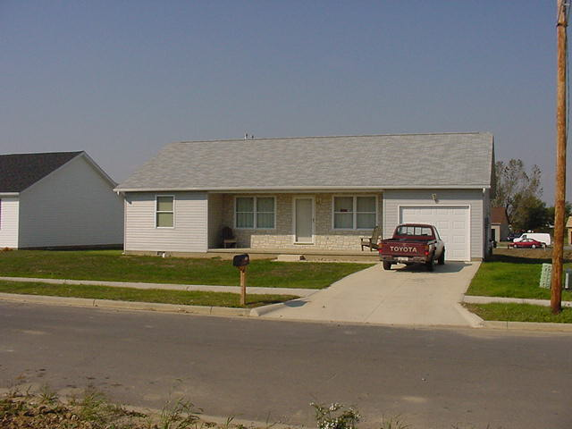

Slide 47
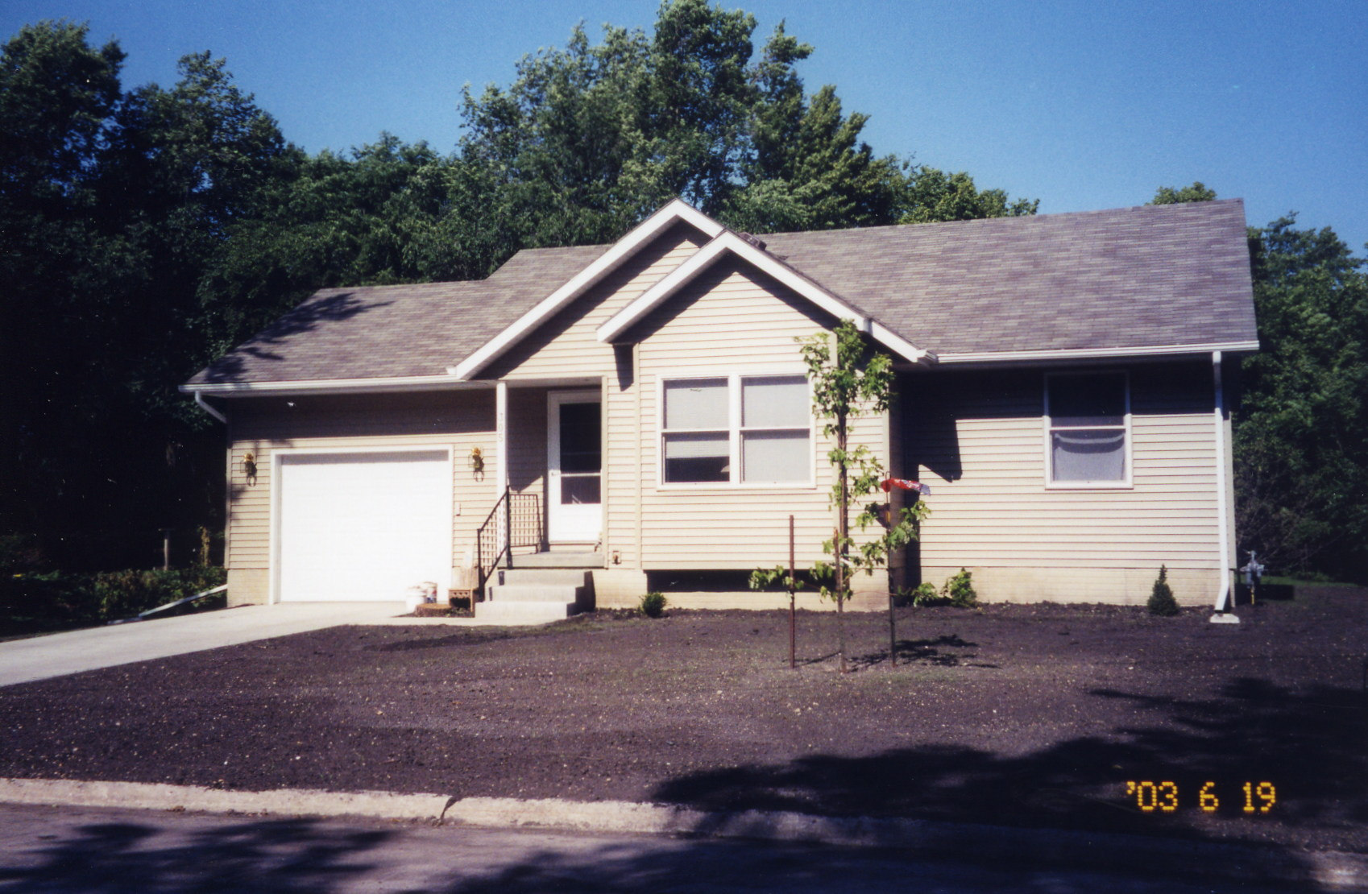

Slide 48
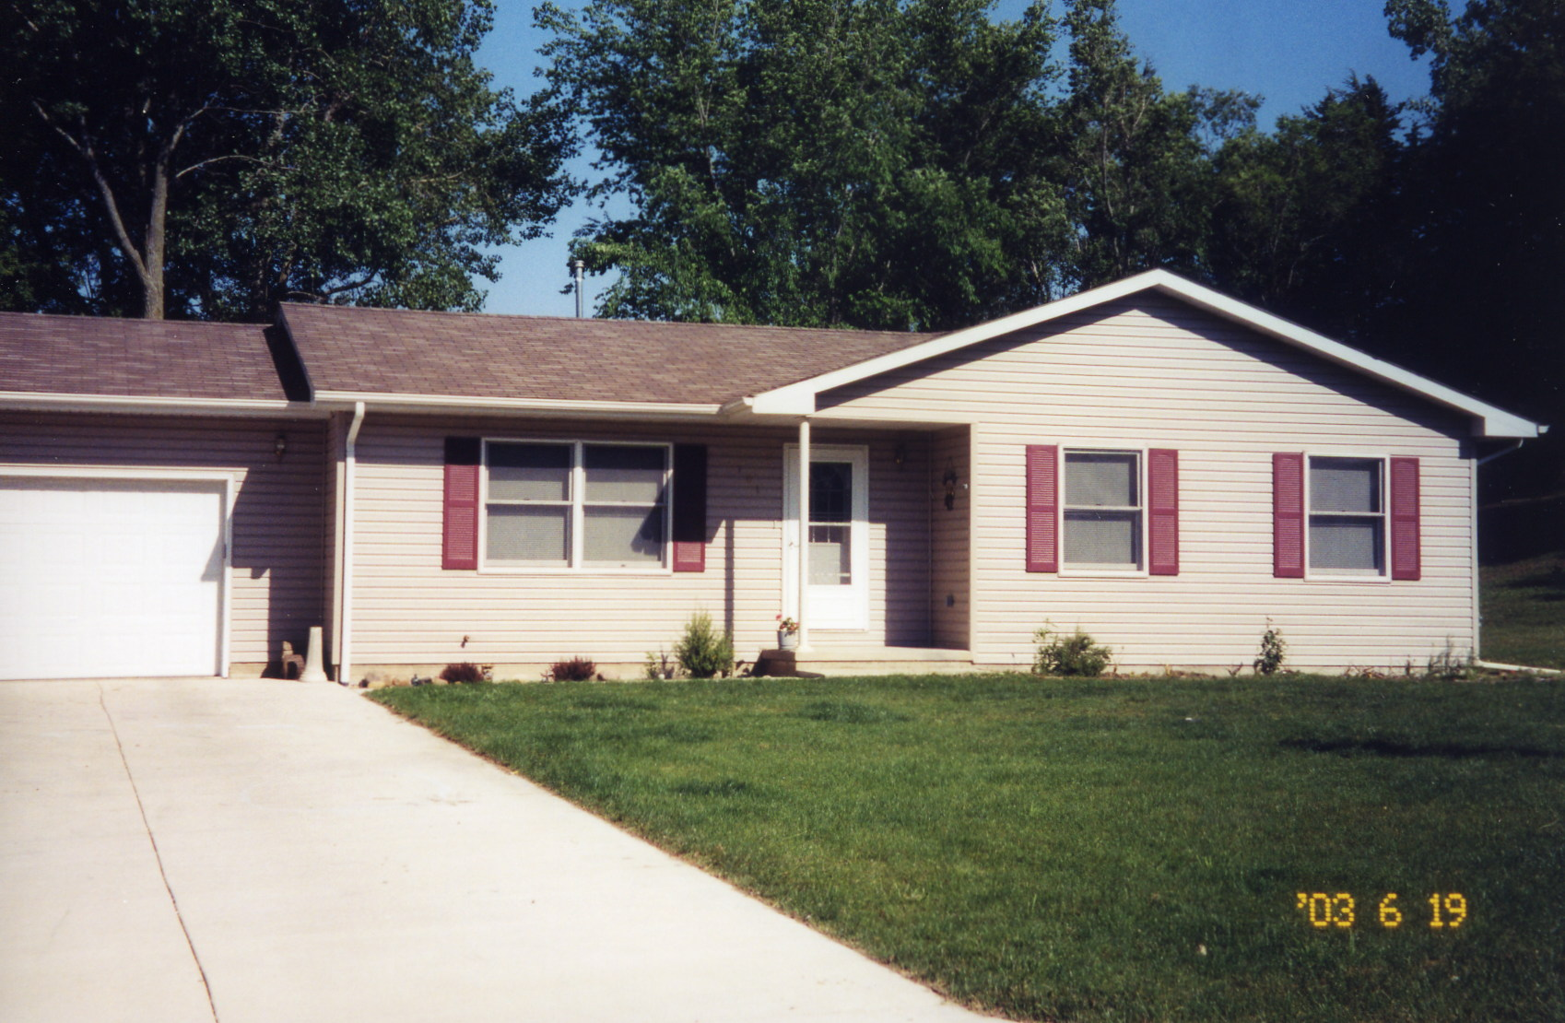

Slide 49
Support
The Self-Help Program gets support from both parties in Congress as well as the USDA!

Slide 50
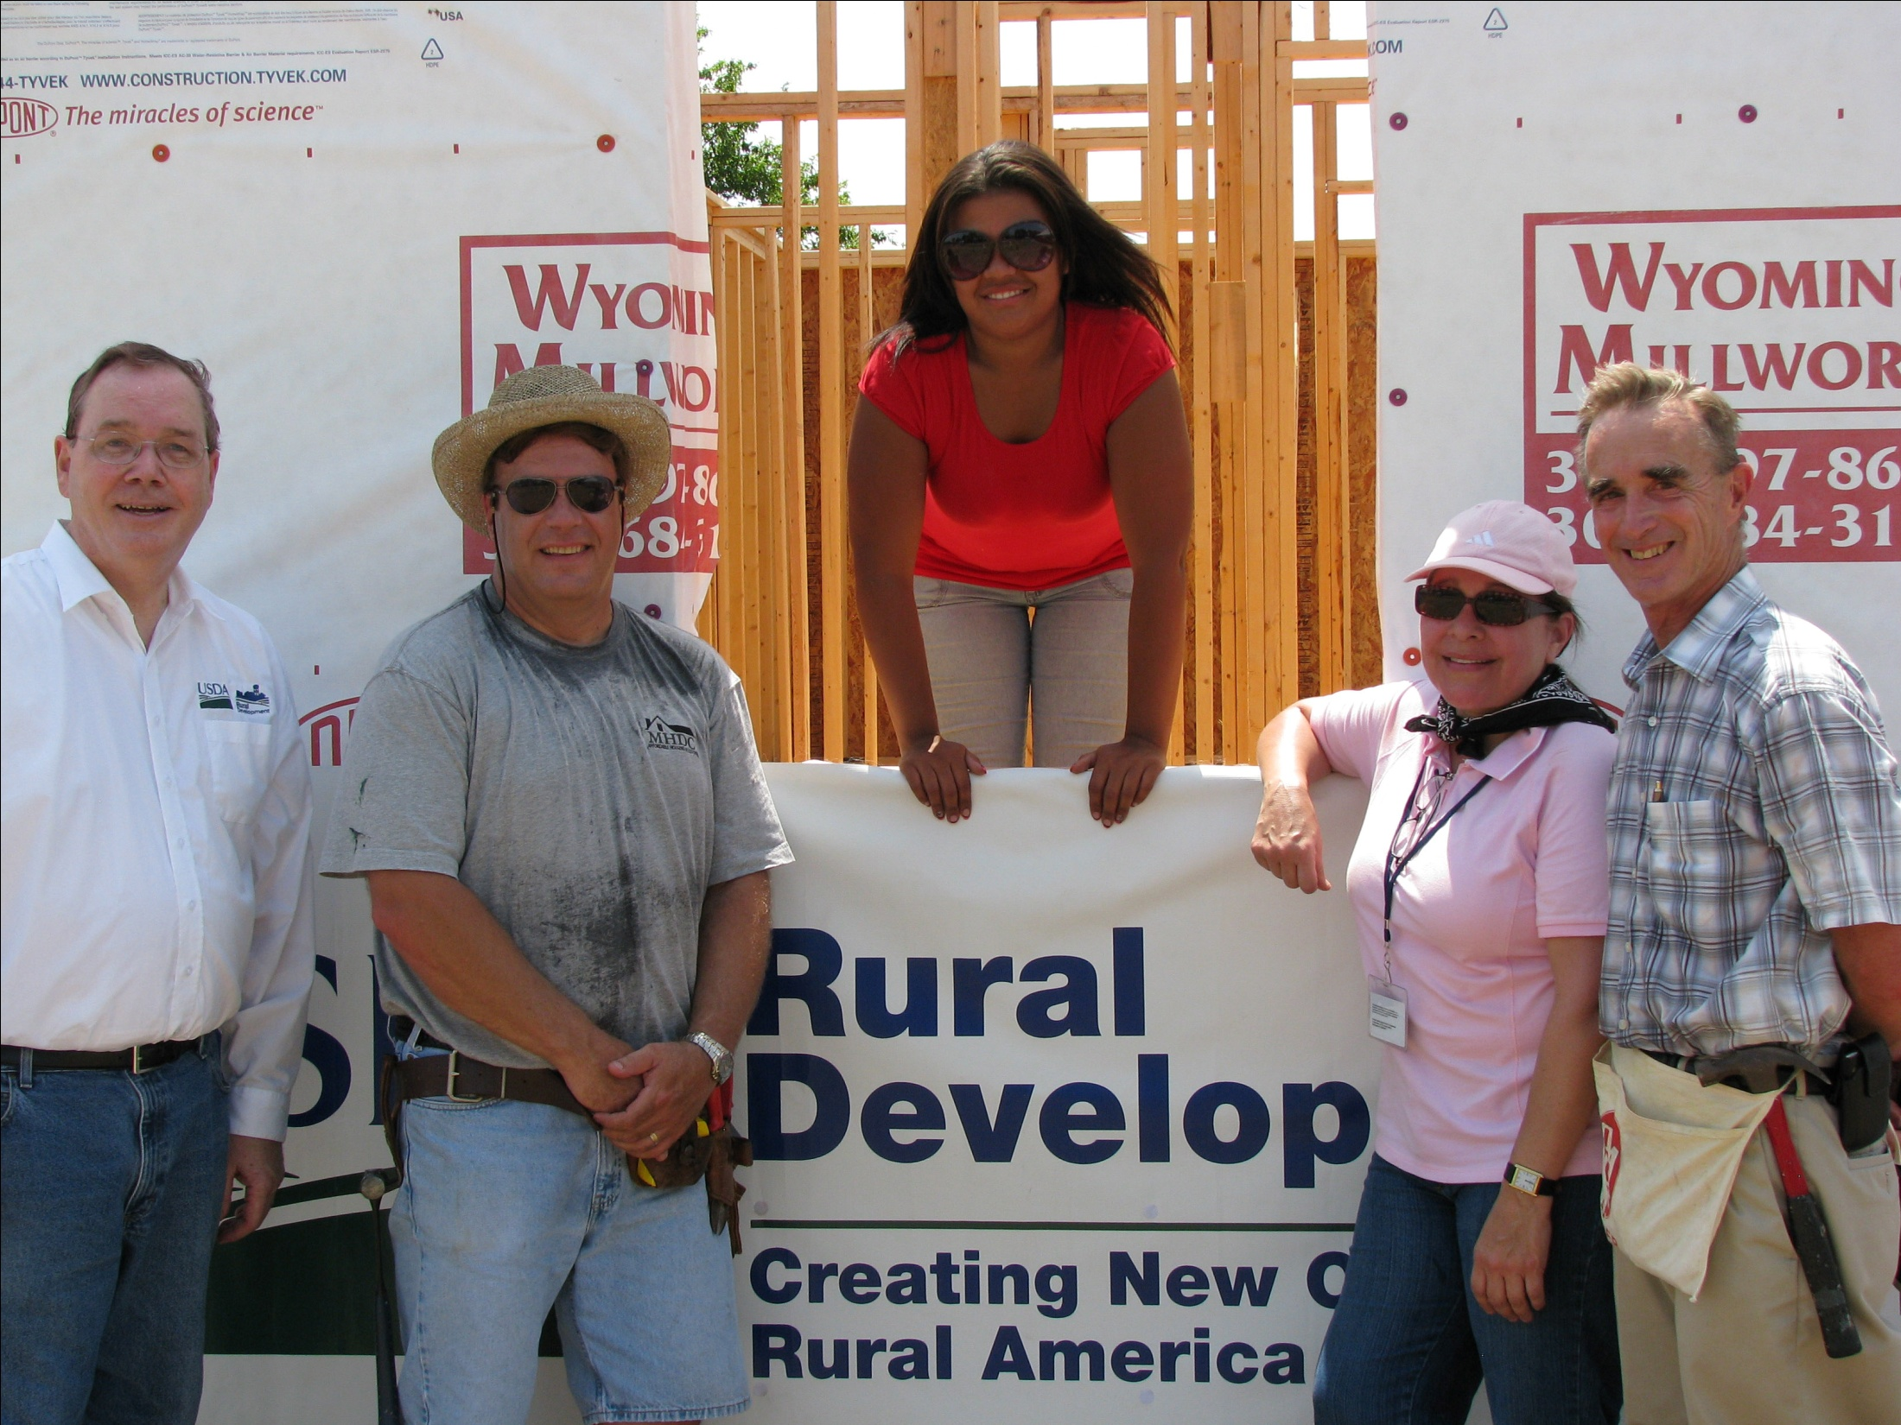

Slide 51
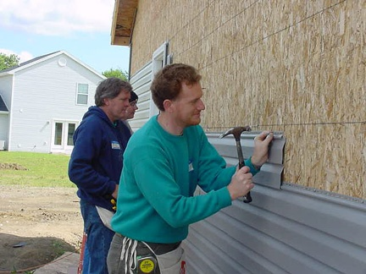

Slide 52
NCALL Self-Help Statistics
Currently 14 grantees operating with 14 grants
$33,580 average sweat equity in FY’09
Over $10 million in 502 funds in FY ‘09
Over $2.5 million in 523 grants in FY ‘09

Slide 53
Now What?
If your organization is interested:
  Feasibility Study
    Helps determine if your organization and area are right for the program
    Submit to NCALL with request to proceed with application training
  NCALL gets approval from National office
  Schedule a meeting and provide application training

Slide 54
THE END

